Slide 1
Sales Trend Analysis Using Aggregations

Slide 2
1.Create a Database
CREATE DATABASE salesdb;
USE salesdb;
2.Create the Table
CREATE TABLE sales (
order_id VARCHAR(50),
order_date DATE,
total DECIMAL(10,2)
);

Slide 3
3.Import CSV into MySQL
LOAD DATA INFILE 'C:/path/to/sales.csv'
INTO TABLE sales
FIELDS TERMINATED BY ','
ENCLOSED BY '"'
LINES TERMINATED BY '\n'
IGNORE 1 ROWS;

Slide 4
4.Run Aggregation Query
SELECT
EXTRACT(YEAR FROM order_date) AS year,
EXTRACT(MONTH FROM order_date) AS month,
SUM(total) AS monthly_revenue,
COUNT(DISTINCT order_id) AS order_volume
FROM sales
GROUP BY year, month
ORDER BY year, month;

Slide 5
5.Filter for Time Periods
SELECT
EXTRACT(YEAR FROM order_date) AS year,
EXTRACT(MONTH FROM order_date) AS month,
SUM(total) AS monthly_revenue,
COUNT(DISTINCT order_id) AS order_volume
FROM sales
WHERE order_date BETWEEN '2020-01-01' AND '2020-12-31'
GROUP BY year, month
ORDER BY year, month;

Slide 6
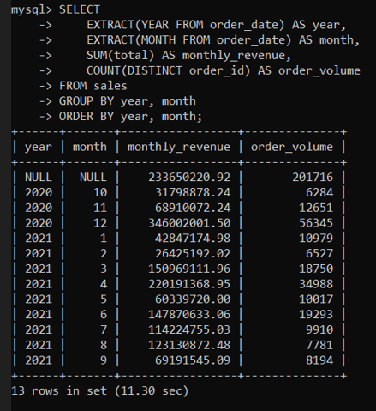
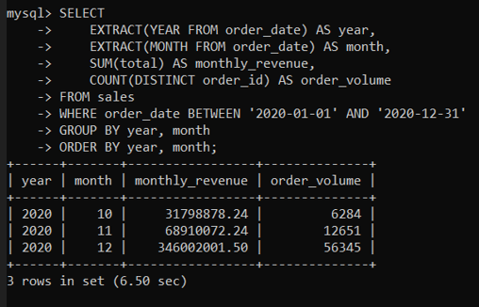
6.Output:

